Slide 1
3D Scene Modeling: Reconstruction, Detection, and Tracking
Prof. Yi Fang
yfang@nyu.edu
Spring, 2016

Slide 2
Announcement
Final project presentation on May 6th
Please feel free to set up appointments about Final project .

Slide 3
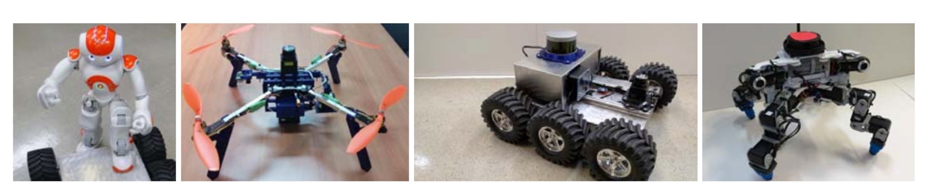
Data Acquisition for MMVC & CCRL Lab
Notes:
CCRL: control/robotics research lab

Slide 4
Today’s Content
3D Scene Reconstruction
3D Detection and Tracking
3D Scene Segmentation and Semantic Labeling

Slide 5
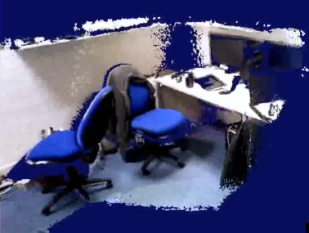
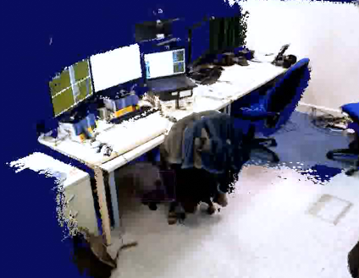
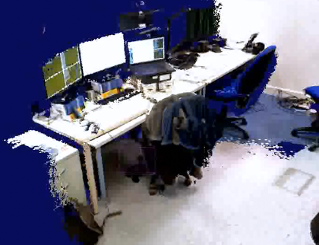
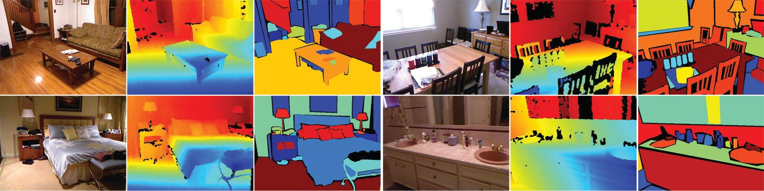
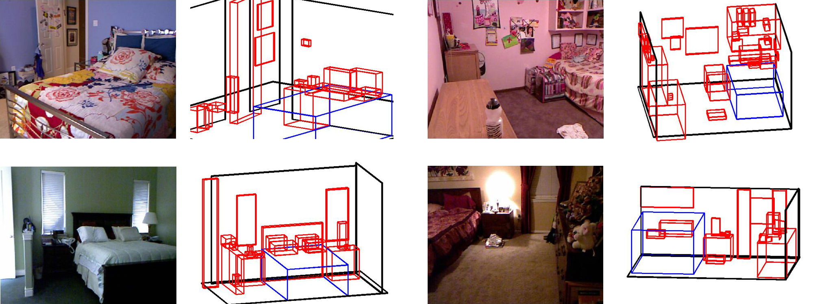
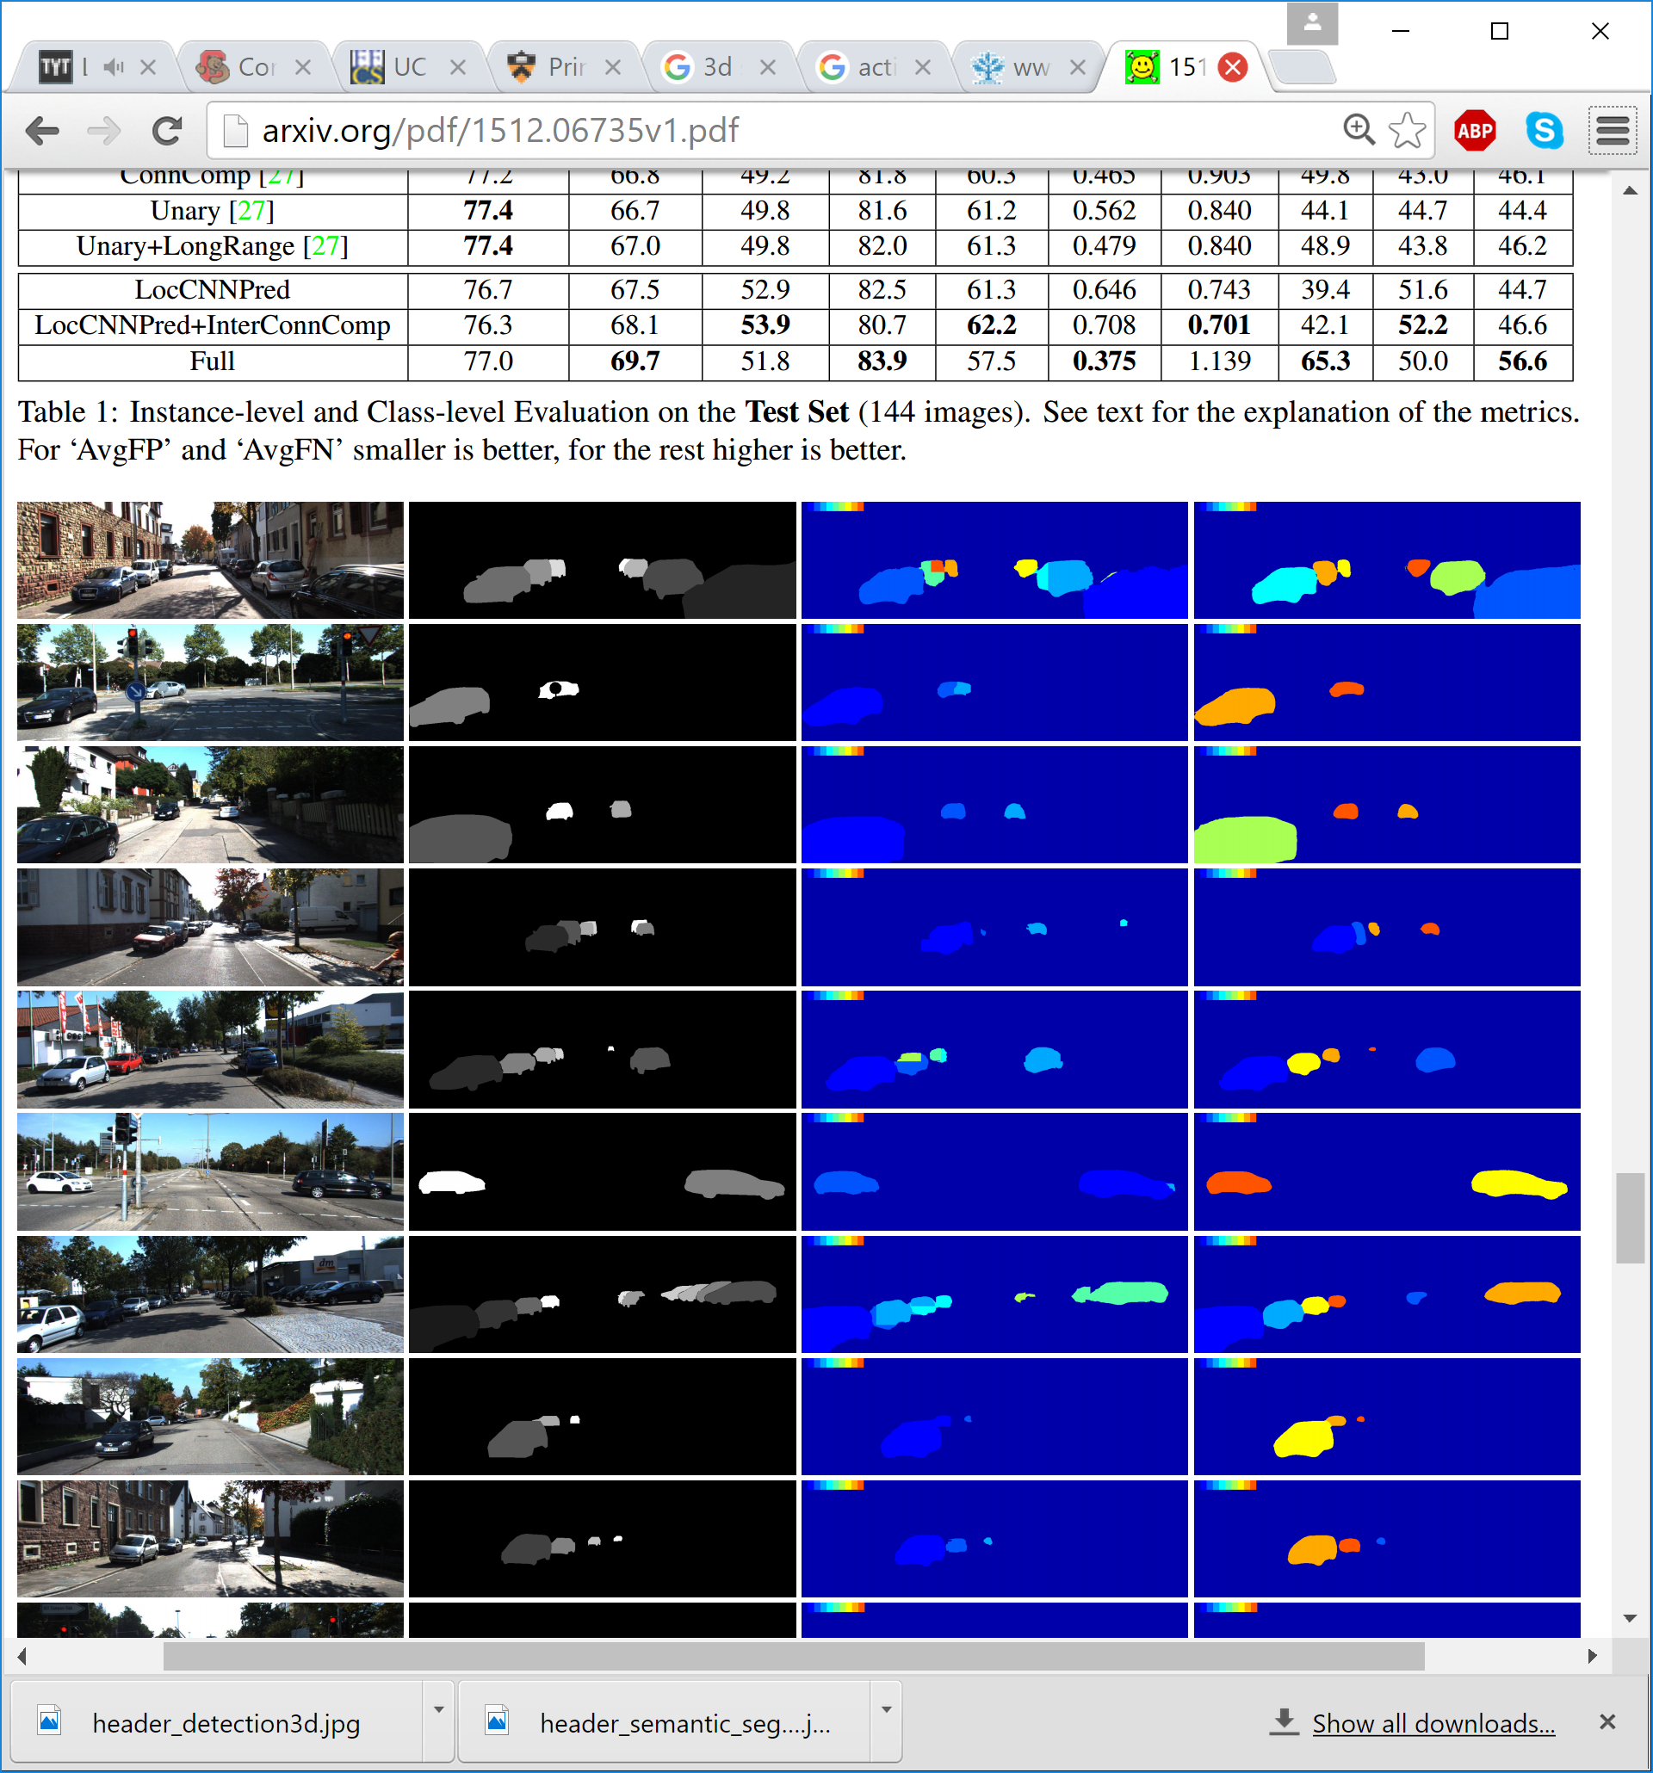
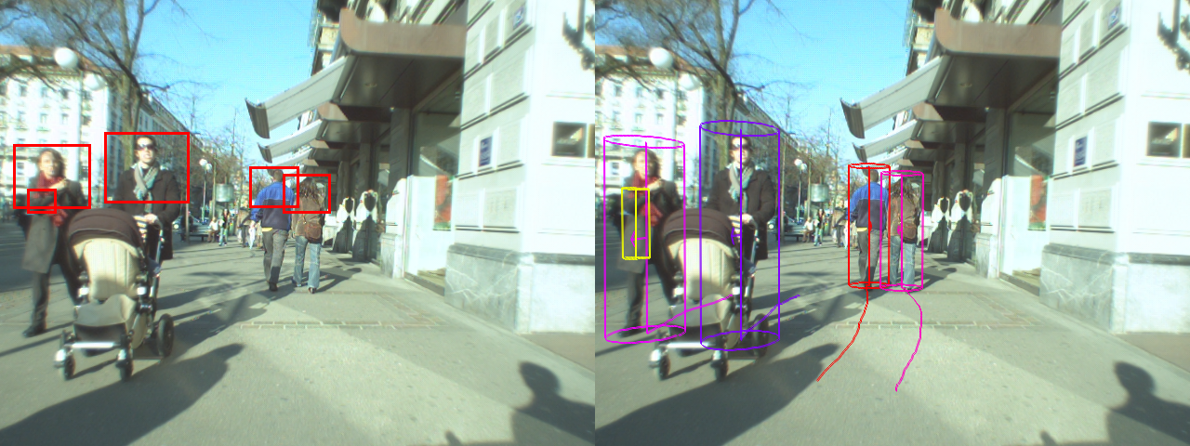
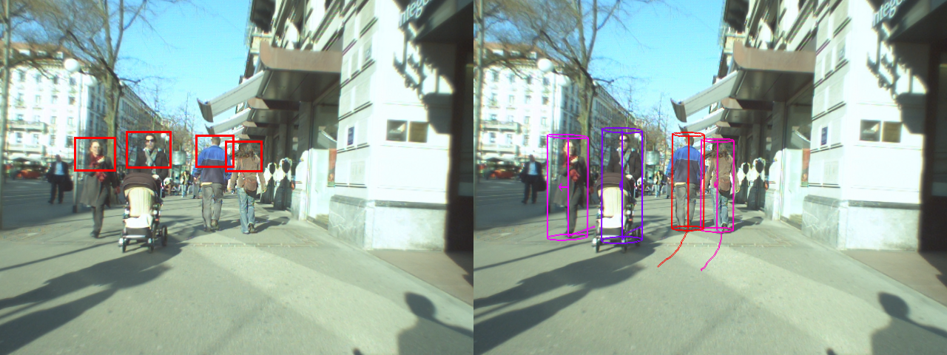
3D Reconstruction
3D Segmentation & Labeling
3D Tracking

Slide 6
3D Scene Reconstruction
3D Scene Reconstruction is the creation of 3D point cloud from multiple RGB-D images for capturing shape and appearance of real objects
The reconstruction framework consists of the following:
Preprocess the depth map using Bilateral filter
Convert the depth map into 3D vertex map using camera calibration matrix and evaluate the normal for each point in the vertex map
Down sample the depth map twice by averaging nearby pixels and evaluate corresponding vertices, normal and curvatures for each map in the pyramid
Find corresponding points in consecutive frames by using fast projective data association method assuming small motion from one frame to the other

Slide 7
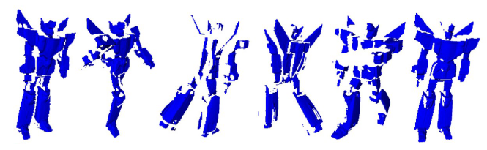
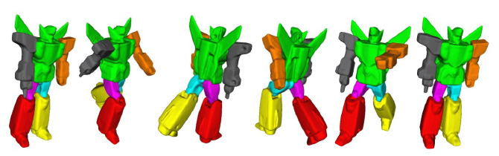
An example of 3D reconstruction
1. Kaick, A Survey on Shape Correspondence, 2010
2. Pokrass, Sparse Modeling of Intrinsic Correspondence

Slide 8
A Review of Iterative closest point algorithm

Slide 9
Geometric Transformation Estimation
Point cloud data set
Geometric transformation estimation
Point cloud data sets registration
Iterative closest point algorithm

Slide 10
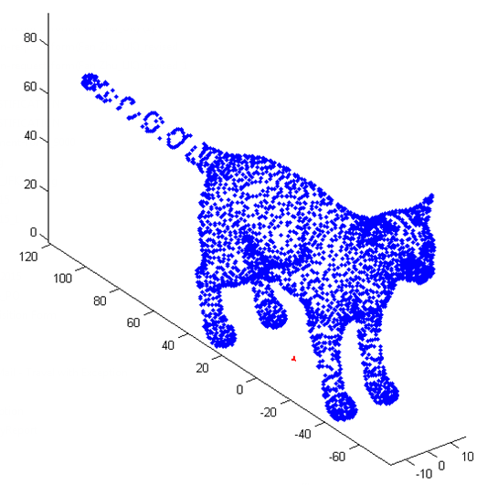
3D Point Cloud

Slide 11
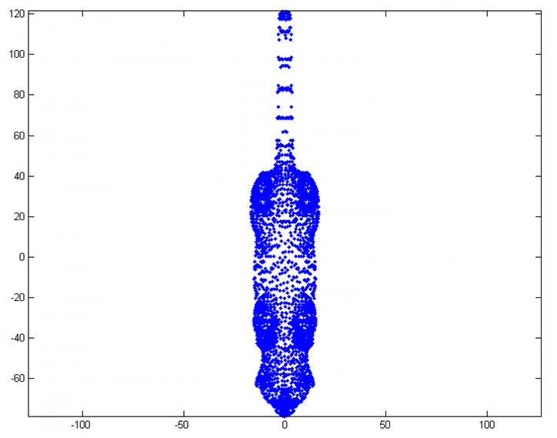
2D Point cloud

Slide 12
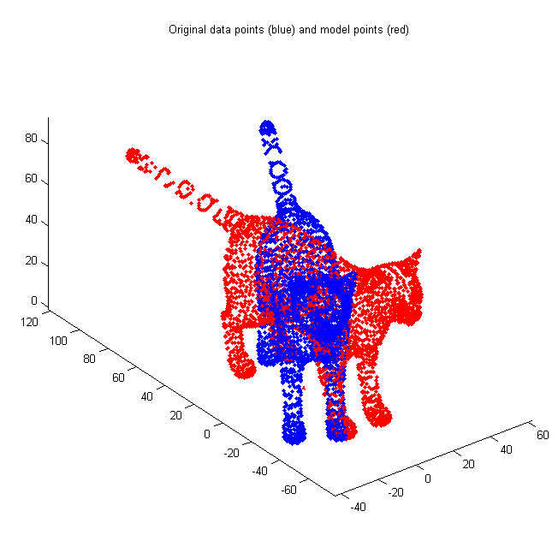
Registration between two sets of point clouds

Slide 13
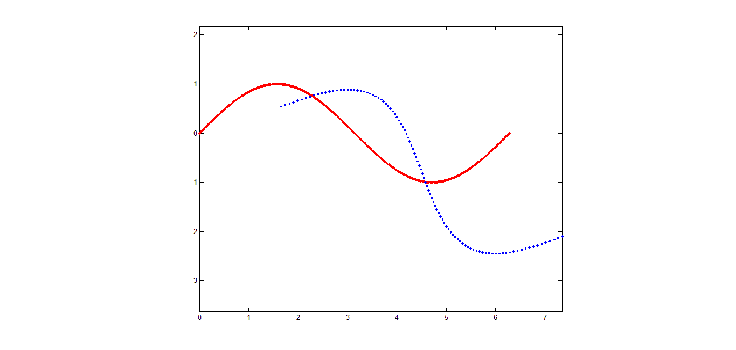
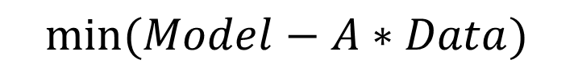
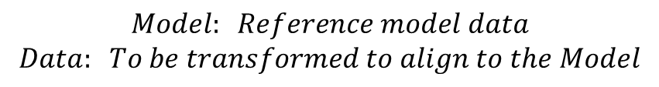
Iterative Closest Point
The MSE objective function :
$$min⁡(Model−A∗Data)$$
$$Model: Reference model data$$
$$Data: To be transformed to align to the Model$$
Model
Data

Slide 14
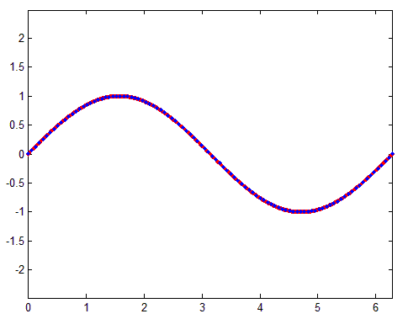
Transform

Slide 15
What if we do not have prior correspondence?
Solution: Assume closest points correspond

Slide 16
Closest Point
Given two points p₁ and p₂ , the Euclidean distance is:
Given a point p₁ and set of points Q , the closest point is defined:

Slide 17
Iterative process
Given the correspondence determined by closest point algorithm, we could update the transformation step by step using Kabsche Algorithm
Where is subset of M which is the set of the closest points to D

Slide 18
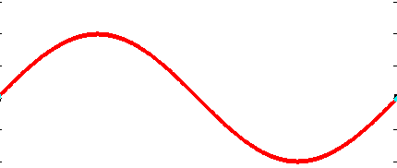
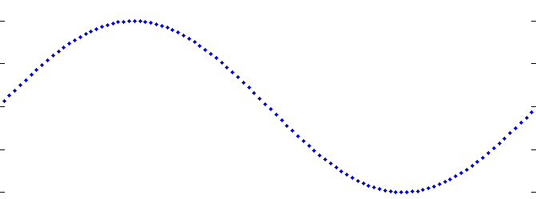
After One Iteration

Slide 19
Re-search Closest Point

Slide 20
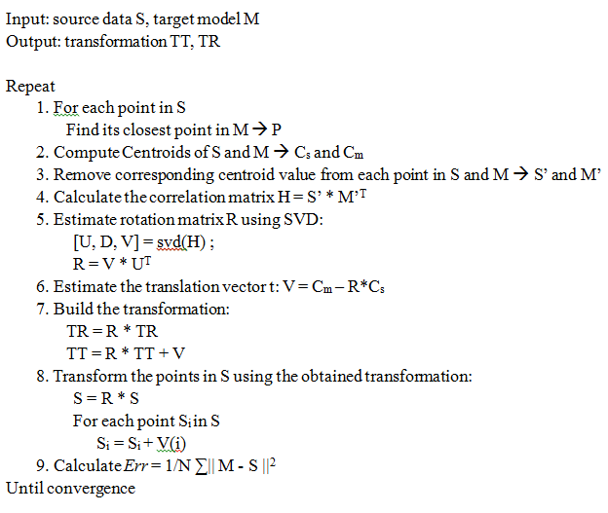
ICP Algorithm
Step 2

Slide 21
Demo Process
Step 1

Slide 22
Step 2

Slide 23
Step 3

Slide 24
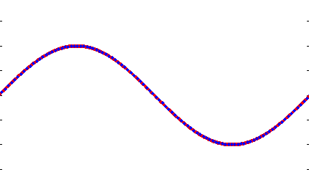
Step n

Slide 25
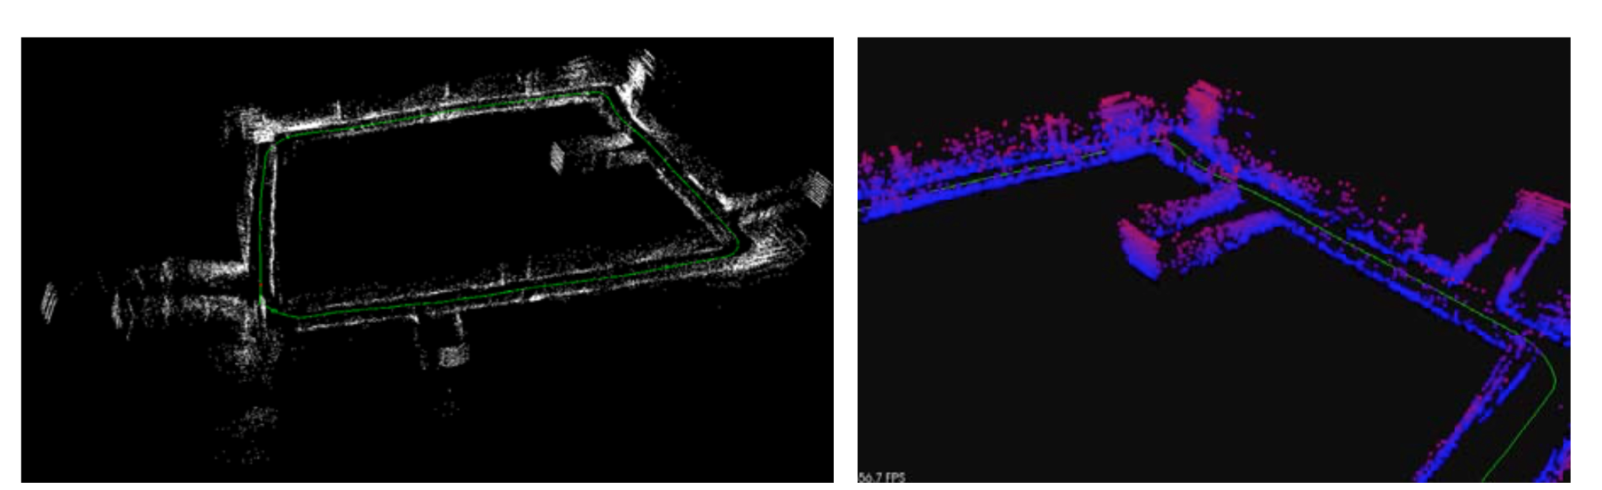
Experimental result of a LIDAR-based SLAM
A building at NYU Tandon

Slide 26
3D Scene Reconstruction Demo

Slide 27
Today’s Content
3D Scene Reconstruction
3D Detection and Tracking
3D Scene Segmentation and Semantic Labeling

Slide 28
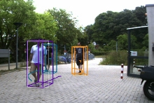
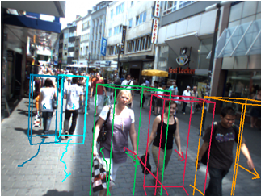
3D Detection and Tracking
Omid Hosseini, etc, Real-Time RGB-D based People Detection and Tracking for Mobile Robots and Head-Worn Cameras, ICRA 14

Slide 29
Tracking Scheme
Integrate the point cloud data in a 2-D histogram
This module extracts ROIs by projecting the 3D points onto the ground plane and segmenting the resulting blobs into individual objects. For each extracted 3D ROI, generate a corresponding ROI in the image plane through back-projection
Pedestrian Detection and Tracking
Trajectory Estimation

Slide 30
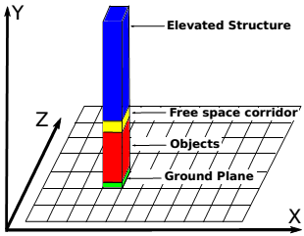
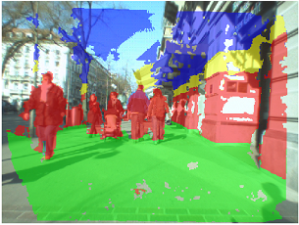
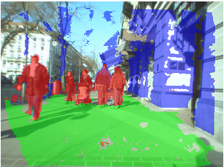
Tracking Scheme
Integrate the point cloud data in a 2-D histogram:
Perform a structure labeling to classify the 3D points into three different classes ( object, ground plane, fixed structure)

Slide 31
Fixed structure points are directly filtered out
Points that are classified as ground plane are passed to the ground plane estimation module, which fits a plane to these points using RANSAC
Points that belong to the object class are passed to the ROI (Region of Interest) processing module

Slide 32
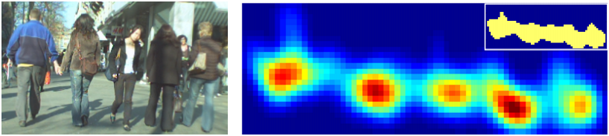
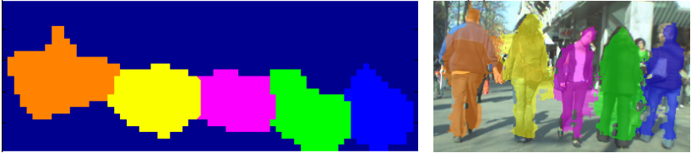
ROI Extraction
This module extracts ROIs by projecting the 3D points onto the ground plane and segmenting the resulting blobs into individual objects. For each extracted 3D ROI, generate a corresponding ROI in the image plane through back projection

Slide 33
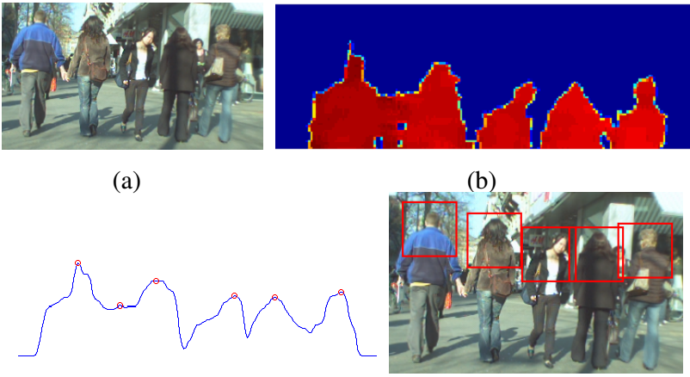
Upper Body Detection
The upper-body detector operates on depth only and consequently is limited to the range available from depth sensors (e.g., Kinect), which is usually up to 5 meters

Slide 34
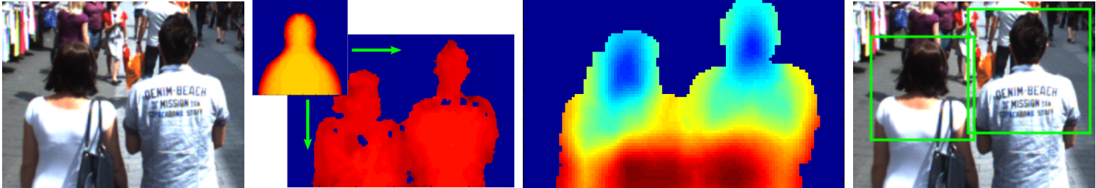
People detection
The 2D ROIs are passed to the depth-based upper-body detector, which slides a learned upper-body template over the ROIs and computes a distance matrix consisting of the Euclidean distances between the template and each overlaid normalized depth image segment

Slide 35
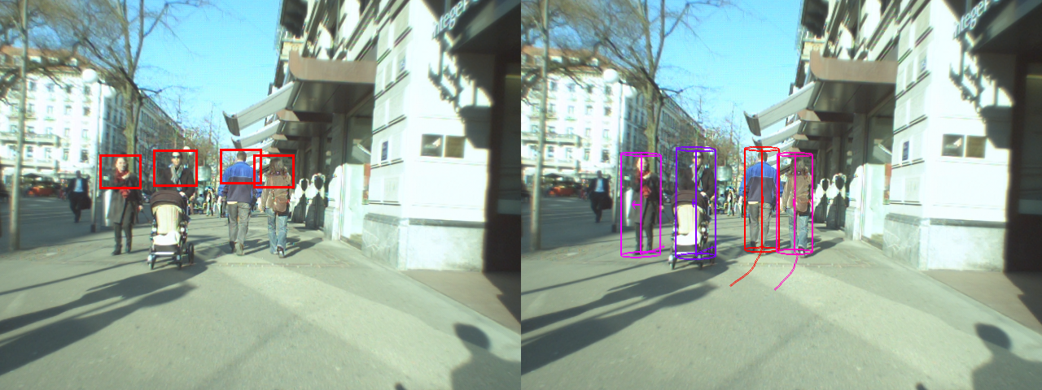
Trajectory Estimation
The bounding boxes are converted to ground plane coordinates and are associated into trajectories using Extended Kalman Filters (EKFs)

Slide 36
3D Detection & Tracking

Slide 37
Today’s Content
3D Scene Reconstruction
3D Detection and Tracking
3D Scene Segmentation and Semantic Labeling

Slide 38
3D Semantic Segmentation
Semantic Segmentation deals with recognizing a category for each pixel or a voxel in a scene
State of the art semantic segmentation methods are mostly based on Deep Learning based algorithms

Slide 39
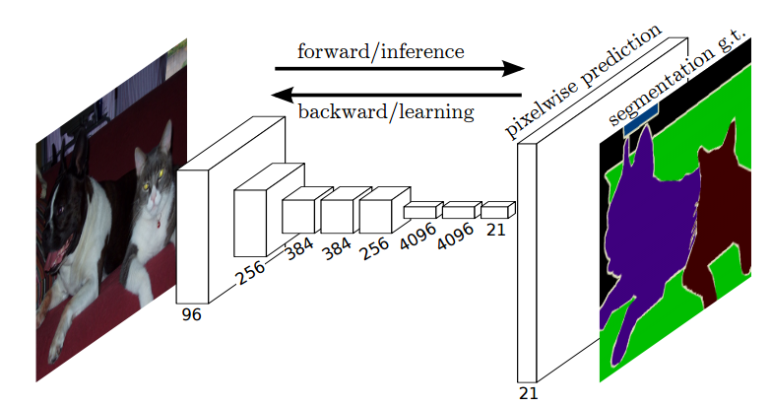
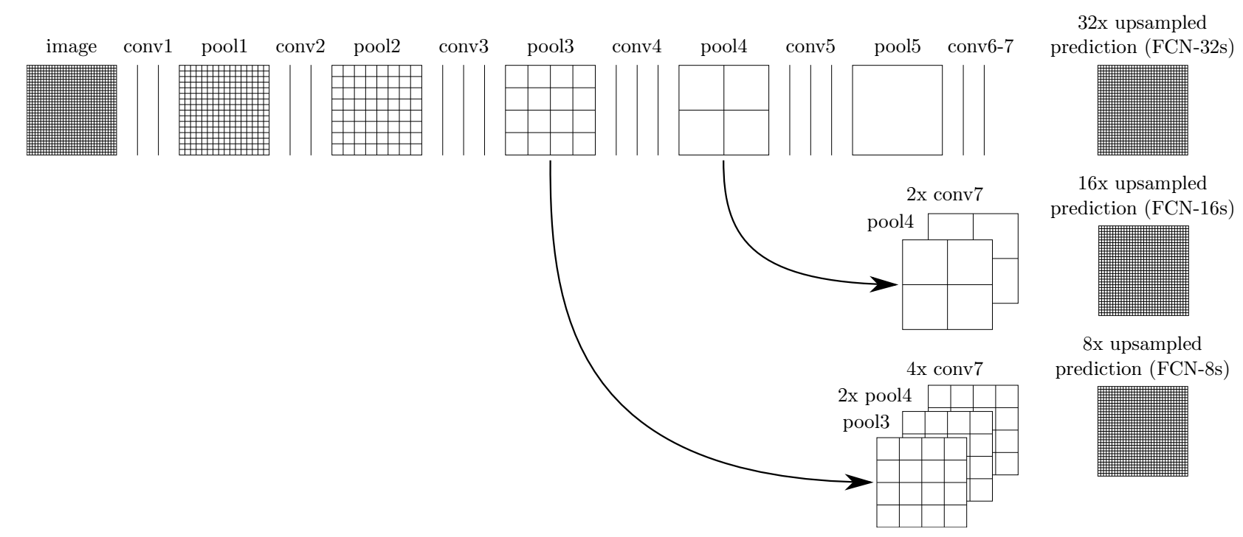
3D Semantic Segmentation (FCN)

Slide 40
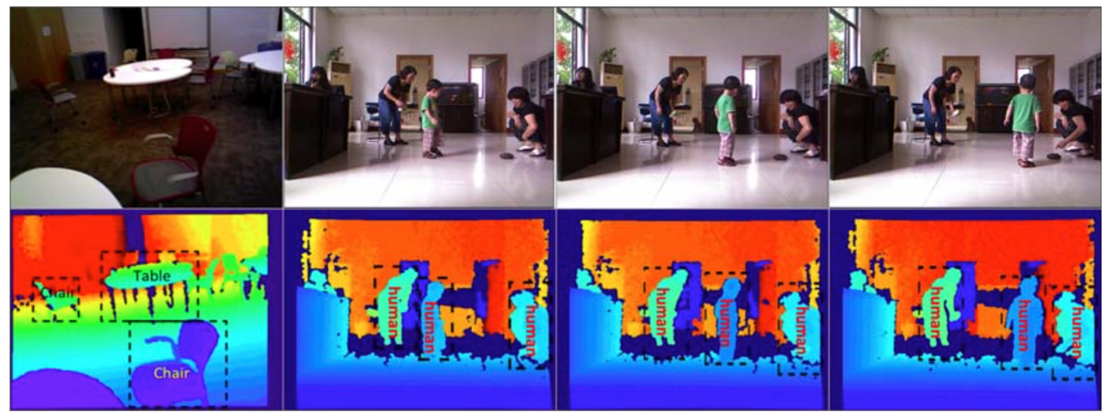
3D Semantic Segmentation Result
Source: J. Xiao, SUN Database, Princeton University

Slide 41
Good Luck on Your Final Demo!

